Slide 1

AI-Powered E-Commerce Recommendation System
Revolutionizing online shopping with personalized experiences, driving user engagement, boosting sales, and solving cold-start challenges.

Slide 2

The E-Commerce Challenge
Generic recommendations limit sales and user satisfaction. New users and products lack data, leading to a "cold-start" problem.
Low Conversion Rates
Typical 2-3% conversion from generic recommendations
Cold-Start Problem
New users/products lack interaction data for personalization
Information Overload
Users struggle to find relevant products among vast selections
Significant Revenue Loss
$1.7 trillion lost annually due to poor recommendations

Slide 3





Our Solution: A Hybrid AI Approach
We combine advanced AI techniques to create a personalized, dynamic recommendation system.
Hybrid AI Combination
Blends collaborative filtering, content-based, NLP, and clustering
Text Analysis
TF-IDF for descriptions, Sentence Embeddings for semantics
User Segmentation
K-Means clustering groups users by behavior
Enhanced Outcomes
Personalized suggestions, improved engagement, boosted sales

Slide 4

Collaborative Filtering
Harnessing user-item interactions to recommend items based on similar user preferences or item popularity.
Interaction Matrix
Memory-Based Approaches
Model-Based Techniques
Addressing Bias
Uses user-item interaction data to build recommendations.
Employs user-based and item-based methods for recommendations.
Leverages techniques like Matrix Factorization (SVD, ALS).
Actively handles popularity bias and recommendations for long-tail items.
Recommendation Example
If User A and User B like X, Y, and User A likes Z, Z is recommended to User B.

Slide 5
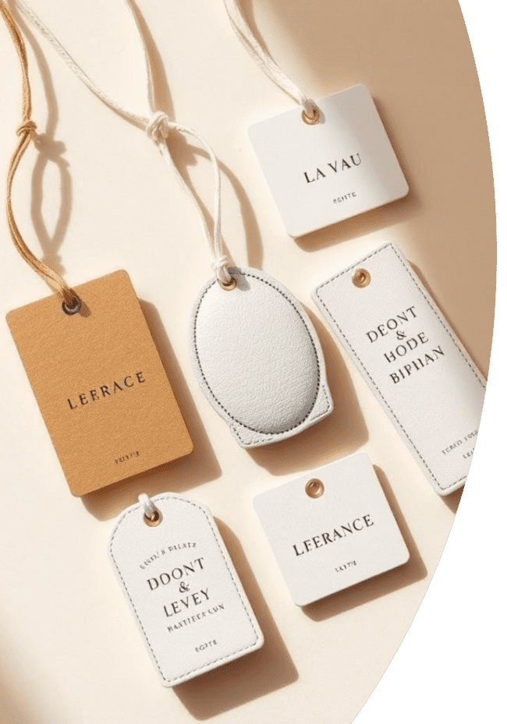




Content-Based Filtering
Recommends items similar to those a user has liked in the past, based on product attributes.
Attribute Analysis
Examines product descriptions, features, categories
TF-IDF Weighting
Identifies importance of key terms in descriptions
Cosine Similarity
Measures how similar products are based on content
Cold-Start Solution
Effective for new products without user interaction data

Slide 6





NLP and Sentence Embeddings
Transforms product descriptions into rich vector representations, capturing nuanced semantic meaning for better similarity matching.
Pre-trained Models
Utilizes advanced NLP models like BERT, RoBERTa
Semantic Meaning
Captures deep meaning of product descriptions
Vector Representations
Creates high-dimensional vector embeddings
Improved Accuracy
Enhances identification of semantically similar products

Slide 7








Clustering and User Segmentation
Groups users with similar behaviors and preferences using K-Means, enabling highly targeted recommendations.
Preference-Based
User Grouping
Segments users by behavior/preferences
K-Means algorithm for user clustering
Boosted Conversions
Tailored Suggestions
Increases relevance and conversion rates
Recommendations aligned with segment needs

Slide 8

Performance and Results
Our system delivers significant improvements across key e-commerce metrics, demonstrating strong ROI.
35%
CTR Increase
Click-through rate boost
20%
Conversion Lift
Boost in conversion rate
15%
AOV Growth
Lift in average order value
10%
Bounce Rate Down
Reduced website bounce rate

Slide 9

Addressing Cold-Start Problem
Our hybrid approach effectively provides relevant recommendations even for new users and products with limited data.
Content-Based
Leverages product attributes for new items
Hybrid Strategy
Combines collaborative and content-based methods
New User Profiling
Infers preferences from initial interactions
Progressive Learning
System refines suggestions over time

Slide 10





Future Directions
We are continuously evolving our system to incorporate cutting-edge AI and deliver even more immersive personalized experiences.
Real-time Tracking
Reinforcement Learning
Sentiment Analysis
Incorporating live user behavior
Optimizing recommendations dynamically
Expanding NLP for emotional context
Multi-modal
Integrating image and video content

Slide 11

Thank You!
We appreciate your time and attention today. We look forward to discussing how our AI-powered recommendation system can transform your e-commerce platform.

